Slide 1
Library Management System
SUBMITTED BY
JANA R
GIRIHARAN S
HITHESH K
Hariprasanna S

Slide 2
ABSTRACT
LIBRARY MANAGEMENT SYSTEM is a project which aims in developing a computerized system to maintain all the daily work of library .
A Library management system is a system that is used to maintain the records of the library. The record includes students and teachers who borrowed books from the library.
The library management system only can be used by the admin or Librarian who can add new member like student or teacher in the system along with their details.

Slide 3
INTRODUCTION
The library management system is developed with the help
Python tkinter -> for frontend
MYSQL workbench-> for backend
Python tkinter uses buttons, frame , Entry box , List box ,scroll bar ,Message box and many other many other GUI interfaces.
Where Mysql workbench is used to store data.
The library management system was developed on “visual studio code”

Slide 4
Existing System
In the current existing system, one must manually keep the record of all books and members.
Which take too much time and it is a very long process.
It is also very difficult to extract the data if need.

Slide 5
Problem Statement
The problem in the system is that you have to enter the data of the book and member manually and it too much time.
The data or the detail of the book may include book id, name, price ,due date ,borrowed date, fine amount and actual price of the book.
While borrowing the book the librarian has to enter the due date manually which may be confusing.
The librarian can’t show the full detail of member.

Slide 6
PROPOSED SYSTEM
In our system once the data of the member is added for the next the you have to just update the data.
If a member borrows a new book the librarian just needs to click on the members data along with the book name the member borrowed and just click update button to update the data.
The librarian can show full data of the member along with book he or she borrowed.
The system automatically calculate the due date and time form the current date and time.
The librarian can also delete the member if he or she is no longer part of the library.

Slide 7
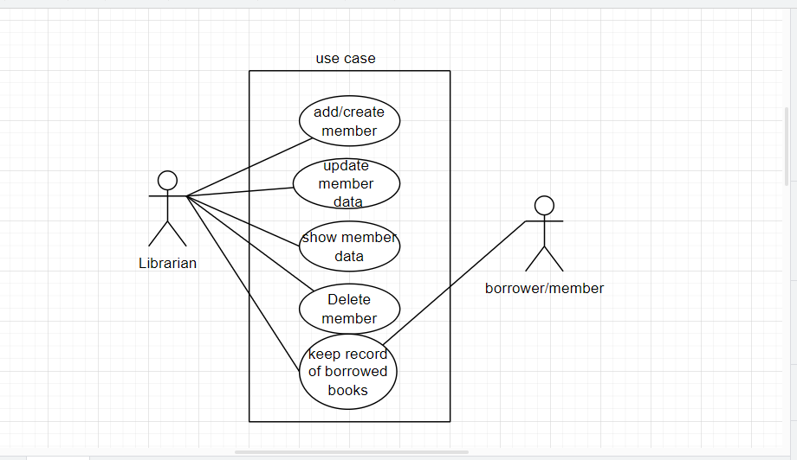
USE CASE DIAGRAM

Slide 8
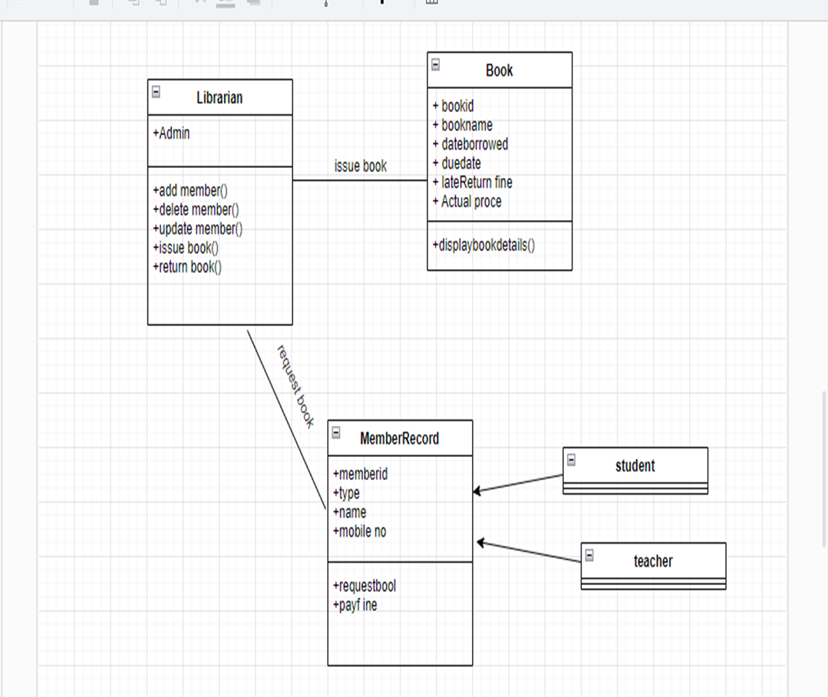
CLASS DIAGRAM

Slide 9
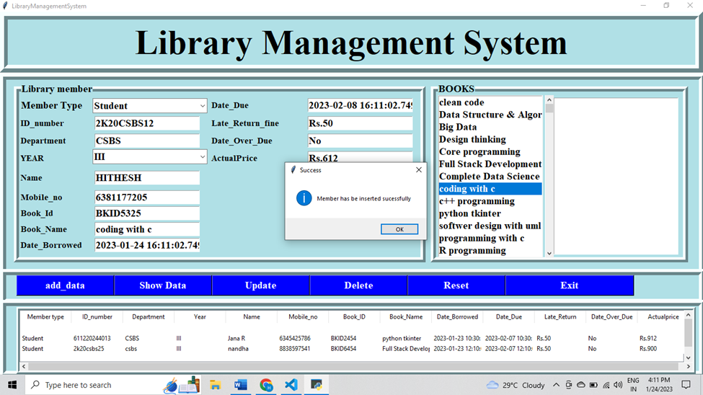
ADDING NEW MEMBER

Slide 10
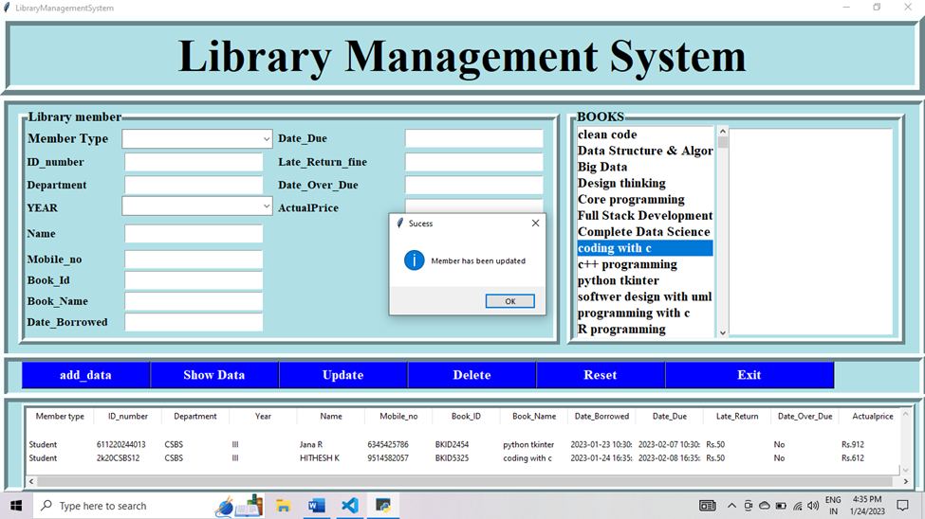
Updating data of member

Slide 11
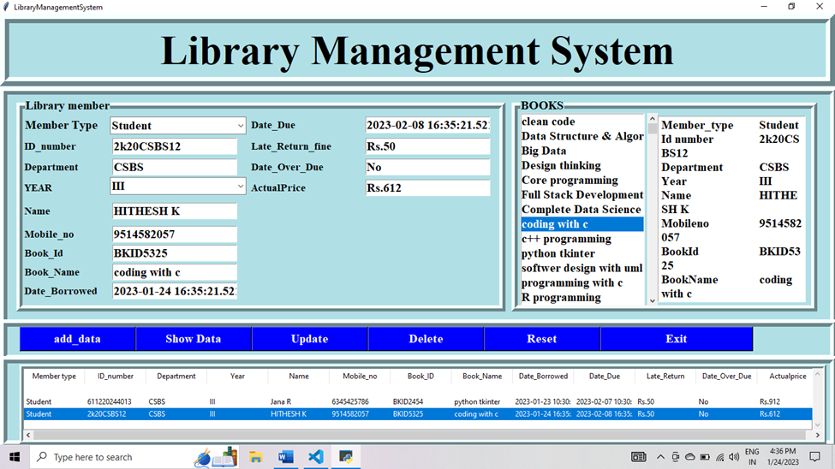
Showing member data

Slide 12
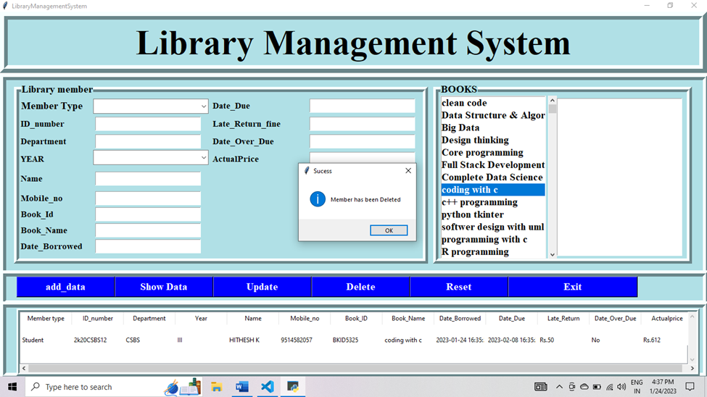
Deleting member from the system

Slide 13
CONCLUSION
The Library system successfully executed and runs and perform the following tasks
1.Add member
2.Update member
3.Delete member
4.Shows the data of member
Also it stores the data of the member in the backend.

